Slide 1
Decision Analysis
Bob Marshall, MD MPH MISM FAAFP
Program Director, DoD Clinical Informatics Fellowship

Slide 2
Objectives
Review/discuss Pareto Charts
Review/discuss Ishikawa/Fishbone Diagrams

Slide 3
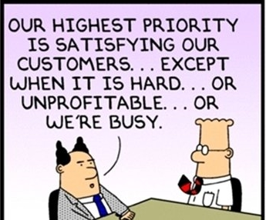
Pareto Charts and Analysis

Slide 4
Pareto Analysis - Overview
A formal technique useful when many possible courses of action are available for a decision
With a Pareto Analysis, the problem-solver
Estimates the benefit derived from each possible action, then
Selects one or more of the most effective actions that potentially deliver as close as possible to the ideal outcome
Pareto Analysis helps to stimulate thinking and organize thoughts
While often thought of as the “80/20 Rule,” that ratio is merely a convenient rule of thumb and not an immutable law

Slide 5
Limitations and Assistive Tools
Pareto Analysis can be limited by the exclusion of possibly important problems, which may be small initially but can grow over time to quite important to the outcomes
Pareto Analysis should be combined with other analytic tools, such as Failure Mode and Effects Analysis (FEMA – discussed previously) and /or Fault Tree Analysis for best effect
PA helps to identify the top portion of causes of the majority of problems so they can be addressed
Once predominant causes are identified, then Ishikawa diagram (discussed later) can be used to identify root causes of the problems

Slide 6
Application of Pareto Analysis
Applied in risk/project management, PA allows leadership to focus on those risks that have the greatest impact on the project
We can apply PA/the 80/20 rule to almost anything:
80% of customer complaints arise from 20% of your products and services.
80% of delays in the schedule result from 20% of the possible causes of the delays.
20% of your products and services account for 80% of your profit.
20% of your sales force produces 80% of your company revenues.
20% of a systems defects cause 80% of its problems
PA has many applications on quality control and is the basis for the Pareto diagram/chart, a key component of total quality control and Six Sigma

Slide 7
Steps in a Pareto Analysis
Create a vertical bar chart with causes on the x-axis and count (number of occurrences) on the y-axis.
Arrange the bar chart in descending order of cause importance that is, the cause with the highest count first.
Calculate the cumulative count for each cause in descending order.
Calculate the cumulative count percentage for each cause in descending order. Percentage calculation: {Individual Cause Count} / {Total Causes Count}*100
Create a second y-axis with percentages descending in increments of 10 from 100% to 0%.
Plot the cumulative count percentage of each cause on the x-axis.
Join the points to form a curve.
Draw a line at 80% on the y-axis running parallel to the x-axis. Then drop the line at the point of intersection with the curve on the x-axis. This point on the x-axis separates the important causes on the left (vital few) from the less important causes on the right (trivial many).

Slide 8
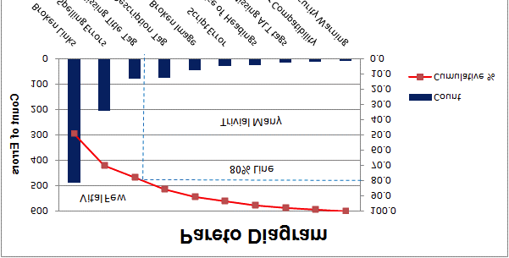
Here is a simple example of a Pareto diagram, using sample data showing the relative frequency of causes for errors on websites.

Slide 9
The Pareto Analysis for Dummies Version
Identify and list problems
Identify the root cause of each problem
Score problems – scoring method depends on the problem to be solved
Group problems together by root cause
Add up the scores for each group
Take action
Note: this approach is great for identifying the most important root cause to address; it does not account for the cost of doing so

Slide 10
Pareto Chart
Pareto Chart (also called a Pareto Diagram) is a bar graph
It is the visual representation of the Pareto Analysis
By convention:
The lengths of the bars represent frequency or cost (time or money)
They are arranged with the longest bar on the left and the shortest to the right
In this manner, the chart visually represents the most significant issues from THE most important on the left to those problems with the least impact on the right

Slide 11
When to Use a Pareto Chart
When analyzing data about the frequency of problems or causes in a process.
When there are many problems or causes and you want to focus on the most significant.
When analyzing broad causes by looking at their specific components.
When communicating with others about your data.

Slide 12
Pareto Chart Procedure
Decide what categories you will use to group items.
Decide what measurement is appropriate. Common measurements are frequency, quantity, cost and time.
Decide what period of time the Pareto chart will cover: One work cycle? One full day? A week?
Collect the data, recording the category each time. (Or assemble data that already exist.)
Subtotal the measurements for each category.
Determine the appropriate scale for the measurements you have collected.
Construct and label bars for each category.
Calculate the percentage for each category.*
Calculate and draw cumulative sums.*
*Optional

Slide 13
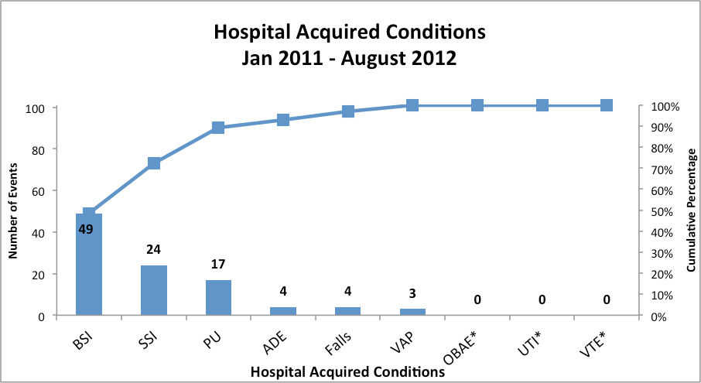
Pareto Chart – Example #1

Slide 14
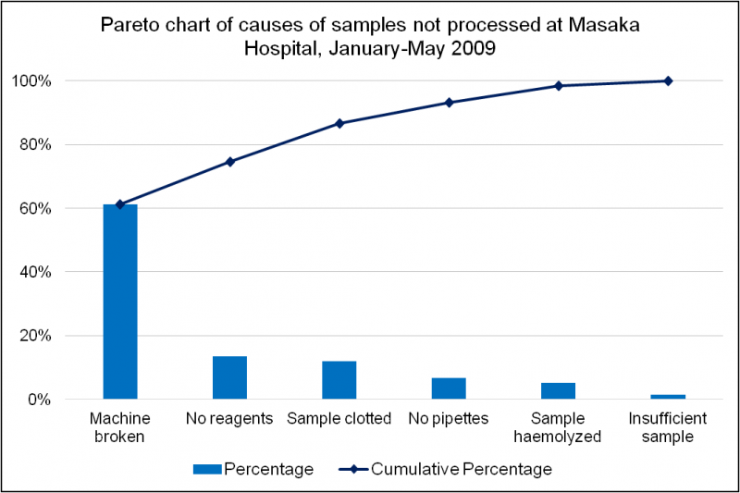
Pareto Chart – Example #2

Slide 15
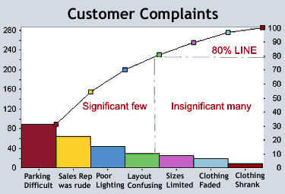
Pareto Chart – Example #3

Slide 16
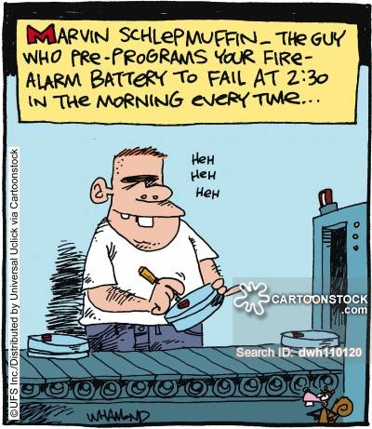
Cause and Effect

Slide 17
Ishikawa/Fish-Bone Diagram
Several synonyms – cause and effect diagrams, herringbone diagrams and Fishikawa diagrams
Cause and Effect Analysis was devised by Professor Kaoru Ishikawa, a pioneer of quality management, in the 1960’s
The diagrams created during this analysis are called Ishikawa or Fishbone diagrams because the resulting diagram can look like a fish skeleton
Although originally developed as a quality control tool, the technique can be used for other purposes, for example:
Discover the root cause of a problem.
Uncover bottlenecks in your processes.
Identify where and why a process isn't working

Slide 18
Common Uses for Ishikawa Diagrams
Common uses of the Ishikawa diagram are product design and quality defect prevention to identify potential factors causing an overall effect.
Each cause or reason for imperfection is a source of variation.
Causes are usually grouped into major categories to identify these sources of variation.
When utilizing a team approach to problem solving, there are often many opinions as to the problem’s root cause.
One way to capture these different ideas and stimulate the team’s brainstorming on root causes is the cause and effect diagram
Because people by nature often like to get right to determining what to do about a problem, the Fishbone Diagram can help bring out a more thorough exploration of the issues behind the problem

Slide 19
Creating a Fishbone/Ishikawa Diagram
Agree on a problem statement (effect)
Brainstorm the major categories of causes of the problem
Write the categories of causes as branches from the main arrow
Brainstorm all the possible causes of the problem
Again ask “why does this happen?” about each cause
When the group runs out of ideas, focus attention to places on the chart where ideas are few.

Slide 20
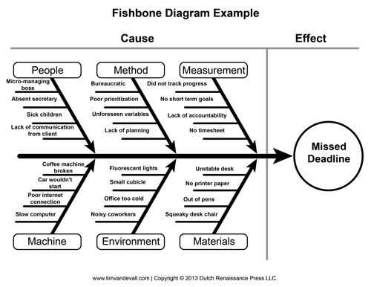
Example of Ishikawa Diagram

Slide 21
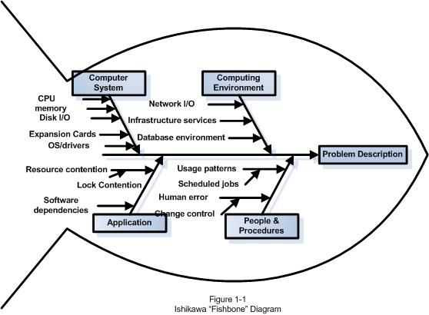
Another Example

Slide 22
Suggested Categories for Fishbone
Service Industries
Policies
Procedures
People
Plant/Technology
Process Steps
Determine Customers
Advertise Product
Incent Purchase
Sell Product
Ship Product
Provide Upgrade

Slide 23
Failure Mode and Effects Analysis (FMEA)

Slide 24
Definition and Synonyms
Failure Mode and Effects Analysis (FMEA) is a structured way to identify and address potential problems, or failures and their resulting effects on the system or process before an adverse event occurs.
In comparison, root cause analysis (RCA) is a structured way to address problems after they occur.
FMEA involves identifying and eliminating process failures for the purpose of preventing an undesirable event
Synonyms: potential failure modes and effects analysis; failure modes, effects and criticality analysis (FMECA)

Slide 25
Some more detail
“Failure modes” means the ways, or modes, in which something might fail.
Failures are any errors or defects, especially ones that affect the customer, and can be actual or potential.
“Effects analysis” refers to studying the consequences of those failures
Failures are prioritized according to how serious their consequences are, how frequently they occur and how easily they can be detected
The purpose of the FMEA is to take actions to eliminate or reduce failures, starting with the highest priority ones
An FMEA is often the ﬁrst step of a system reliability study

Slide 26
When to use FMEA as a Methodology
When a process, product or service is being designed or redesigned, after quality function deployment
When an existing process, product or service is being applied in a new way
Before developing control plans for a new or modified process
When improvement goals are planned for an existing process, product or service
When analyzing failures of an existing process, product or service
Periodically throughout the life of the process, product or service

Slide 27
Another Perspective on When to use FMEA
FMEA is effective in evaluating both new and existing processes and systems.
For new processes, it identifies potential bottlenecks or unintended consequences prior to implementation.
It is also helpful for evaluating an existing system or process to understand how proposed changes will impact the system.
Once you have identified what changes need to be made to the process or system, the steps you follow are those you would use in any type of PIP (Process Improvement Project)

Slide 28
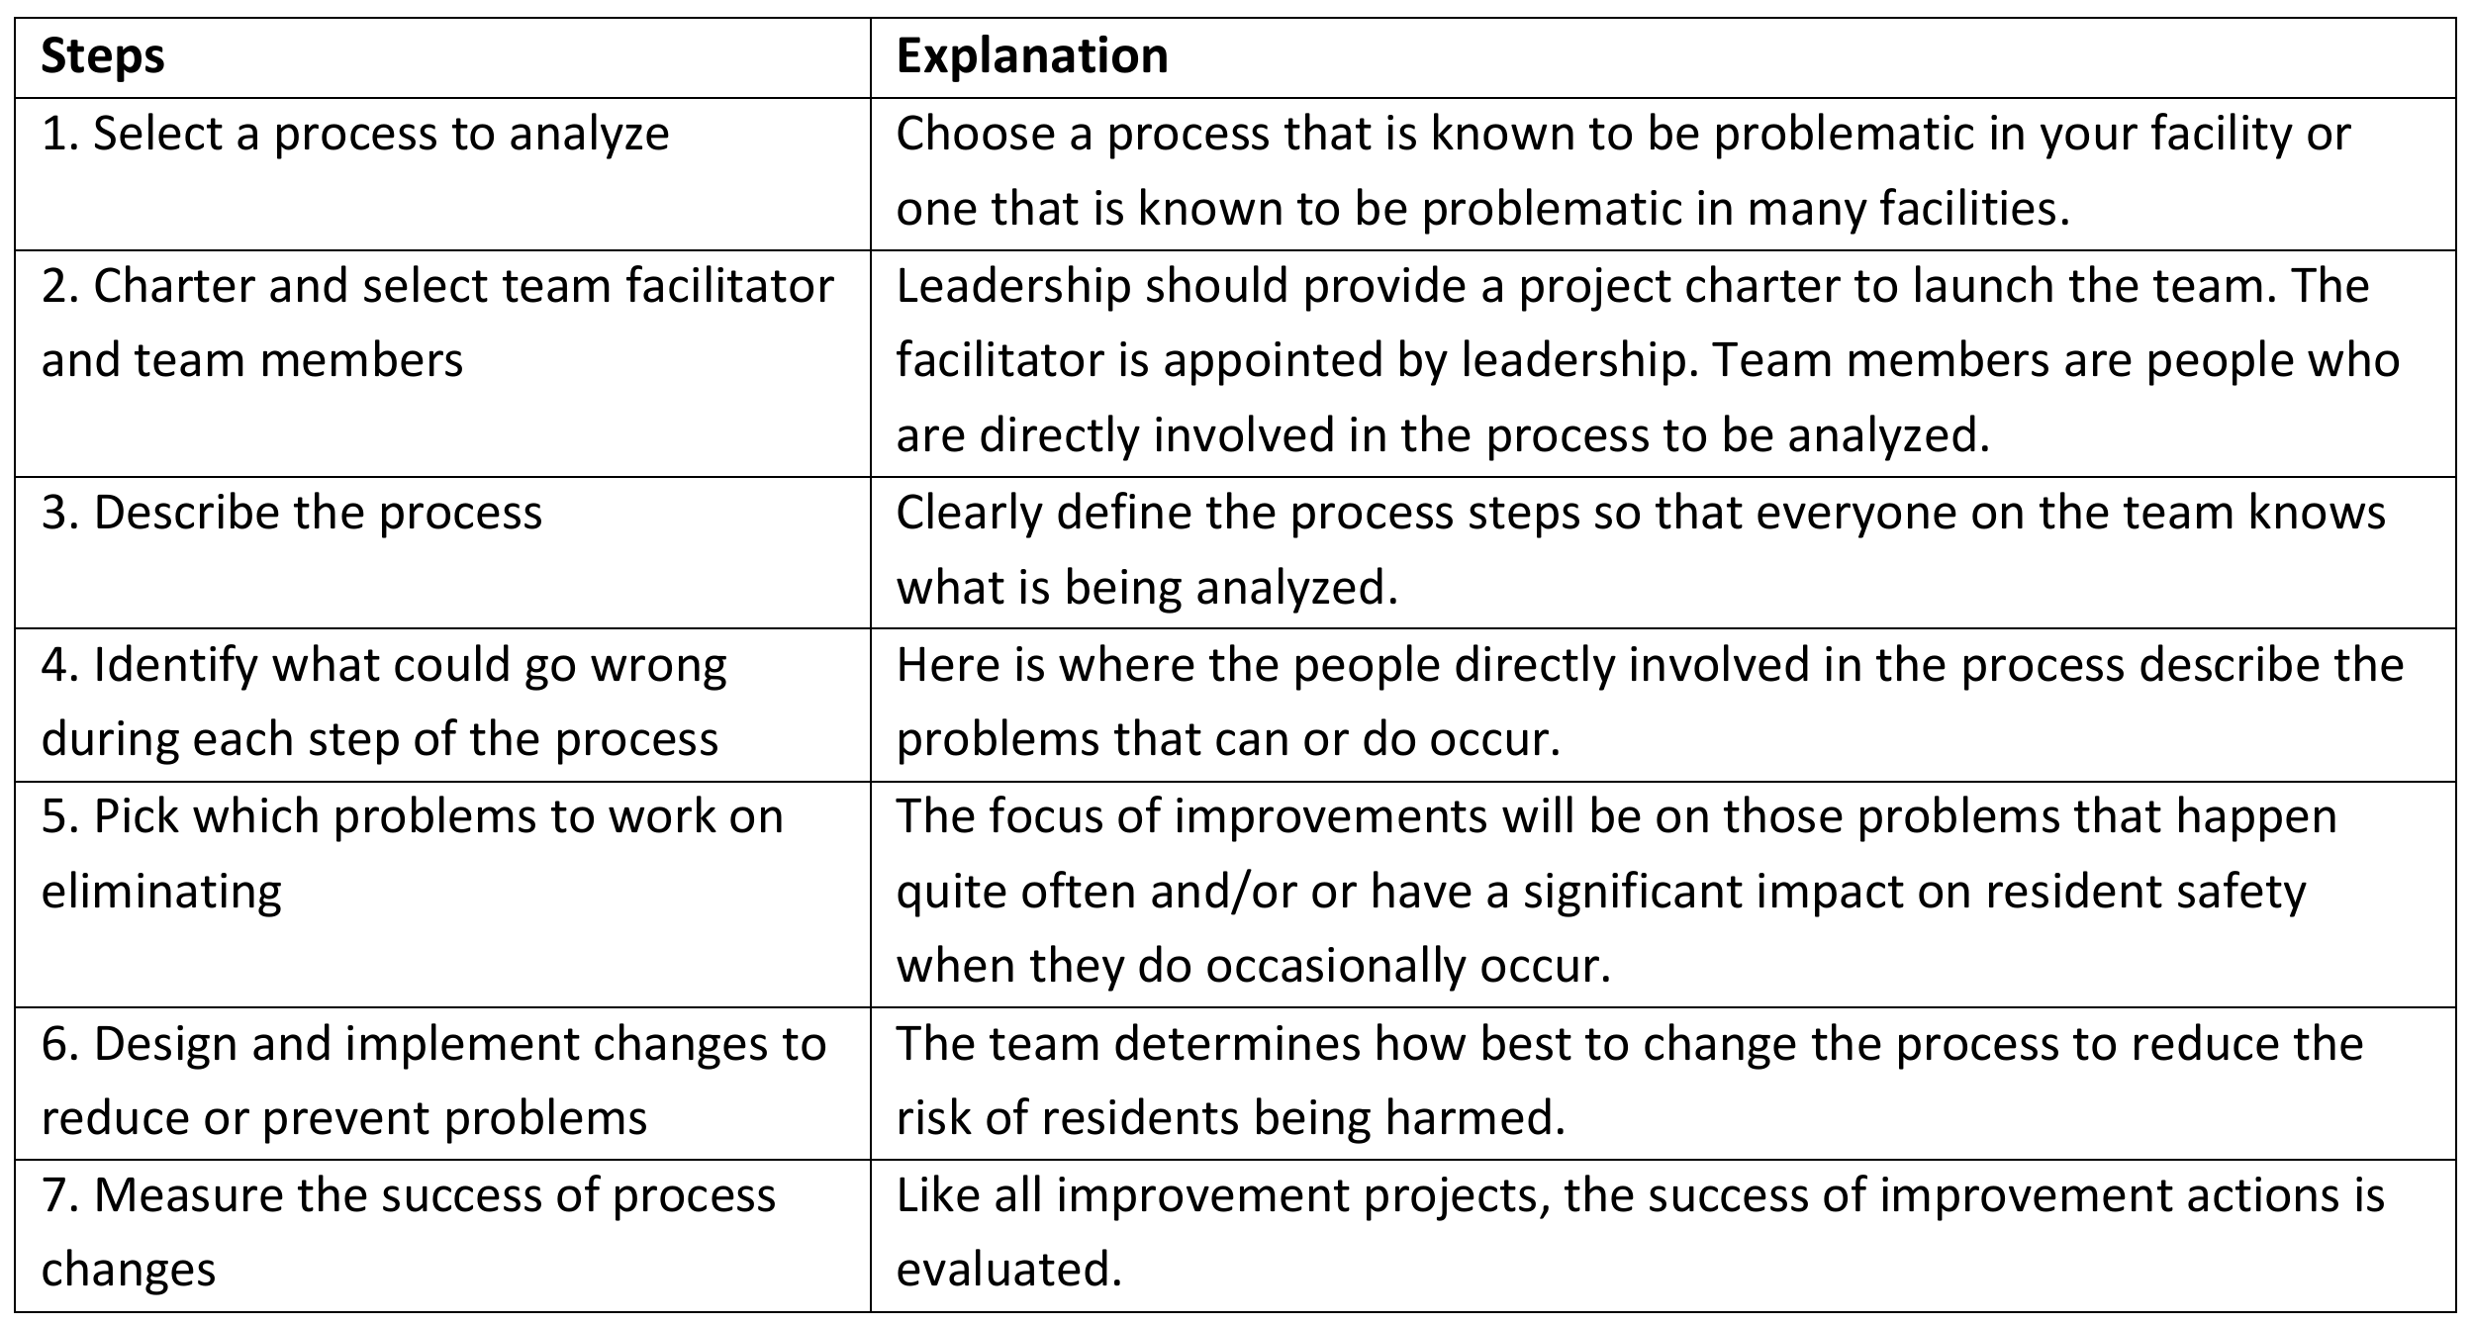
An Outline of the FMEA Procedure

Slide 29
FMEA Procedure (a Longer Outline) 1 of 4
Assemble a cross-functional team of people with diverse knowledge about the process, product or service and customer needs
Identify the scope of the FMEA. Is it for concept, system, design, process or service?
Fill in the identifying information at the top of your FMEA form (see next slide)
Identify the functions of your scope
For each function, identify all the ways failure could happen. These are potential failure modes
For each failure mode, identify all the consequences on the system, related systems, process, related processes, product, service, customer or regulations

Slide 30
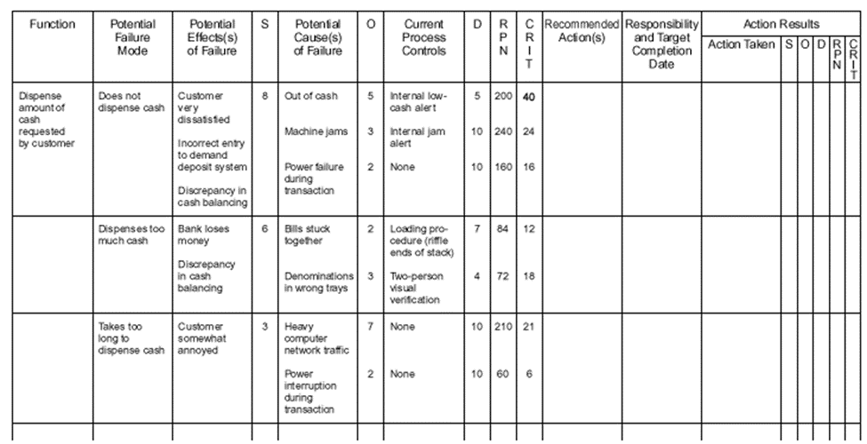

Slide 31
FMEA Procedure (a Longer Outline) 3 of 4
For each failure mode, identify all the consequences on the system, related systems, process, related processes, product, service, customer or regulations. These are potential effects of failure
Determine how serious each effect is. This is the severity rating, or S. Severity is usually rated on a scale from 1 to 10, where 1 is insignificant and 10 is catastrophic
For each failure mode, determine all the potential root causes. Use tools classified as “cause analysis tool”, as well as the best knowledge and experience of the team
For each cause, determine the occurrence rating, or O. This rating estimates the probability of failure occurring for that reason during the lifetime of your scope

Slide 32
FMEA Procedure (a Longer Outline) 4 of 4
For each cause, identify current process controls
For each control, determine the detection rating, or D. This rating estimates how well the controls can detect either the cause or its failure mode after they have happened but before the customer is affected
Calculate the risk priority number, or RPN, which equals S × O × D.
Also calculate Criticality by multiplying severity by occurrence, S × O.
These numbers provide guidance for ranking potential failures in the order they should be addressed
Identify recommended actions
As actions are completed, note results and the date on the FMEA form. Also, note new S, O or D ratings and new RPNs.
Notes:
S = Severity
O = Occurrence
D = Detection rating
RPN: http://www.ihi.org/resources/Pages/Measures/RiskPriorityNumberfromFailureModesandEffectsAnalysis.aspx

Slide 33
Advantages of FMEA
Improve the quality, reliability and safety of a product/process
Increase user satisfaction
Reduce system development time and cost
Collect information to reduce future failures, capture engineering knowledge
Early identiﬁcation and elimination of potential failure modes
Emphasize problem prevention
Minimize late changes and associated cost
Catalyst for teamwork and idea exchange between functions
Reduce the possibility of same kind of failure in future

Slide 34
Limitations of FMEA
In the healthcare context, FMEA and other risk assessment methods, including SWIFT (Structured What If Technique) and retrospective approaches, have been found to have limited validity when used in isolation
Challenges around scoping and organizational boundaries appear to be a major factor in this lack of validity
If used as a top-down tool, FMEA may only identify major failure modes in a system
When used as a “bottom-up” tool FMEA can augment or complement Fault Tree Analysis (FTA) and identify many more causes and failure modes resulting in top-level symptoms

Slide 35
Limitations of FMEA cont.
The multiplication of the severity, occurrence and detection rankings may result in rank reversals, where a less serious failure mode receives a higher RPN than a more serious failure mode
The reason for this is that the rankings are ordinal scale numbers, and multiplication is not deﬁned for ordinal numbers
Ordinal rankings only say that one ranking is better or worse than another, but not by how much.
For instance, a ranking of “2” may not be twice as severe as a ranking of “1”
However, multiplication treats them as if they are

Slide 36

Questions?

